Slide 1



App Resources and Supporting Multiple Screens
Tushar Sharma

Slide 2

Contents:
App-Resource Definition
Types of Resources
Resource-Directory Tree Structure
Types of Resource-Directories
Assets
Supporting Multiple Screens
Density Independence
Screen-Compatiblity Examples

Slide 3
App Resources
Definition:
Resources are
additional declarative files and static content.
Android creates resource IDs
for using them in Java programs.

Slide 4
Types of Resources:e.g.
String: R.string.Str_android | Color-Drawable: R.drawable.rectangle_green
Color: R.color.Yellow | Drawable: R.drawable.img1
Style and Theme: R.style.styleresource | Layout: R.layout.appresources
Dimension: R.dimen.medium_size | Menus: R.menu.menus
Animation | Property animation Frame animation View animation: R.anim.frameanim

Slide 5
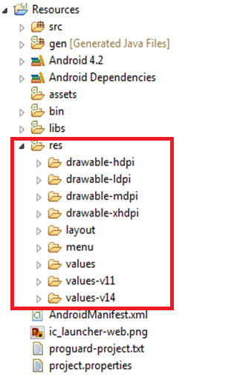
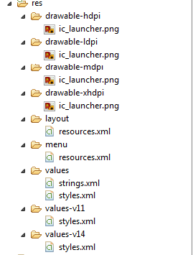
Resource-Directory Tree Structure

Slide 6

Type of Resource Directories
Resource-Directories
anim/
View animation
animator/
Property animation
Drawable
drawable/
layout/
Layout
Color-Drawable
menu/
Menu
raw/
Raw
Color
values/
Color-Drawable
xml/
Xml files
Dimension
String
Style

Slide 7
Assets
Assets are directory used to store raw assets files.
Files saved in the assets/ directory are not given a resource ID.
We can query files in the assets/ directory like a normal file system and read raw data using AssetManager.
Files that save in assets are compiled into an .apk file, and the original filename is preserved.
AssetManager assetManager = getAssets();
InputStream instream = assetManager.open("file.txt");
7

Slide 8

Screen characteristic | Qualifier | Description/Example
Size | Small | QVGA low density(426dp x 320dp).
 | Normal | HTC Magic screen size(470dp x 320dp).
 | Large | Typical example is Aakash tablet, like device(640dp x 480dp).
Density | Ldpi | 100 to 140 dpi .
 | Mdpi | 140 to 180 dpi . (Aakash tablet 160dpi)
 | Hdpi | 190 to 250 dpi .
Aspect Ratio | Long | taller (in portrait mode) and wider (in landscape mode) aspect ratio than the baseline screen configuration. (Aakash 16:9).
 | Notlong | aspect ratio similar to the baseline screen configuration.
Orientation | Landscape, Portrait | landscape orientation (wide aspect ratio) and portrait orientation (tall aspect ratio)
Where dp is Density-Independent Pixels,
dpi is Dots per inch.

Slide 9
<manifest xmlns:android=http://schemas.android.com/apk/res/android>
<supports-screens android:largeScreens="true" android:normalScreens="true" android:smallScreens="true" android:resizable="true" android:anyDensity="true" />
</manifest>

Slide 10
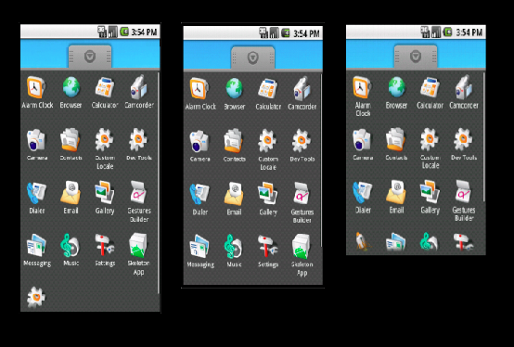
Density independence:
This is used to express layout Dimension or Position (in density independent way).
http://jayxie.com/mirrors/android-sdk/guide/practices/screens_support.html
10

Slide 11
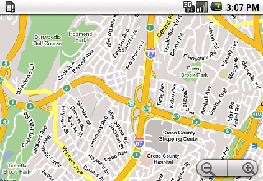
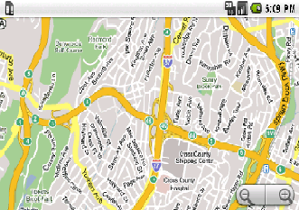
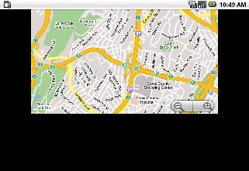
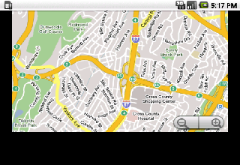
Screen-Compatibility Examples
normal size, normal density
normal size, high density
large size, normal density
large size, high density
http://jayxie.com/mirrors/android-dk/guide/practices/screens_support.html
11

Slide 12
Summary:
Resources are declarative files and static content.
Resource-Directory Tree Structure: which is created
during project compilation.
Supporting Multiple Screens: characteristics are
size, density, aspect-ratio, orientation, and
some set of qualifier.
Density Independence: used to express layout
dimensions or position (in a density-independent way).
12

Slide 13
Reference Book and Links :
http://jayxie.com/mirrors/android-sdk/guide/practices/screens_support.html
http://developer.android.com/guide/topics/resources/index.html
http://developer.android.com/guide/practices/screens_support.html
Professional Android 4 Application Development by Reto Meier.
13

Slide 14
THANK YOU
14

